Slide 1


Unit-04 Objects and Classes
Object Oriented Programming -I (3140705)
Prof. Arjun V. Bala
Computer Engineering Department
arjun.bala@darshan.ac.in
9624822202

Slide 2

Outline
Class
Object
Looping

Slide 3
Class
Class is derived datatype, it combines members of different datatypes into one.
Defines new datatype (primitive ones are not enough).
For Example : Car, College, Bus etc..
This new datatype can be used to create objects.
A class is a template for an object .
Example :
class Car{
String company;
String model;
double price;
double milage;
………
}

Slide 4

Car Class
Class: Car
Properties (Describe)
Company
Model
Color
Mfg. Year
Price
Fuel Type
Mileage
Gear Type
Power Steering
Anti-Lock braking system
Methods (Functions)
Start
Drive
Park
On_break
On_lock
On_turn

Slide 5
Object
An object is an instance of a class.
An object has a state and behavior.
Example: A dog has
states - color, name, breed as well as
behaviors – wagging the tail, barking, eating.
The state of an object is stored in fields (variables), while methods (functions) display the object's behavior.

Slide 6

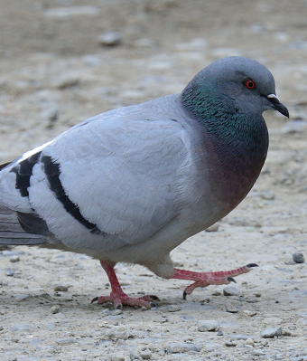
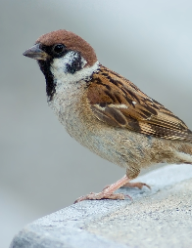
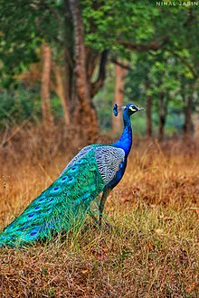

Objects of Class Bird

Slide 7





Objects of a class Car
Honda City
Hyundai i20
Sumo Grand
Mercedes E class
Swift Dzire

Slide 8
Rectangle Class
Properties in rectangle Class
length
width
borderColor
backgroundColor
length = 5
width = 2
borderColor=black
backgroundColor=white
length = 2
width = 5
borderColor=black
backgroundColor=white
length = 3
width = 3
borderColor=red
backgroundColor=white
length = 5
width = 2
borderColor=none
backgroundColor=yellow

Slide 9
Creating Object & Accessing members
new keyword creates new object
Syntax:
ClassName objName = new ClassName();
Example :
SmartPhone iPhone = new SmartPhone();
Object variables and methods can be accessed using the dot (.) operator
Example:
iPhone.storage = 8000;

Slide 10
class Box {
double length;
double breadth;
double height;
}
class BoxDemo {
public static void main(String args[]) {
Box myBox1 = new Box();
Box myBox2 = new Box();
double vol;
myBox1.length = 10;
myBox1.breadth = 20;
myBox1.height = 30;
myBox2.length = 3;
myBox2.breadth = 6;
myBox2.height = 9;
vol = myBox1.length * myBox1.breadth * myBox1.height;
System.out.println("Volume is " + vol);
vol = myBox2.length * myBox2.breadth * myBox2.height;
System.out.println("Volume is " + vol);
}
}
length = 10
length
myBox1
breadth = 20
breadth
height = 30
height
length
length = 3
myBox2
breadth = 6
breadth
height = 9
height

Slide 11
Introducing methods
Methods represents the behavior of a class.
Remember : a Method is always invoked relative to an object. (except ….)
Syntax:
access_specifier return_type method_name(argument_list)
{
// code
}

Slide 12
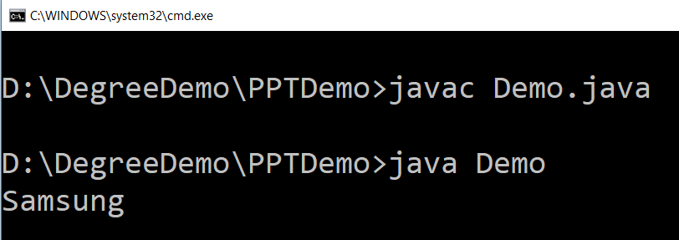
Example (method)
public class SmartPhone {
String manufacturer;
String model;
double storage;
double screenSize;
public String getManufacturer(){
return manufacturer;
}
public void setManufacturer(String a){
manufacturer = a;
}
}
public class Demo {
public static void main(String args[]) {
SmartPhone sp = new SmartPhone();
sp.setManufacturer("Samsung");
String name = sp.getManufacturer();
System.out.println(name);
}
}

Slide 13
Constructor
A constructor is a “special” member method which initializes the objects of class.
Properties of constructor:
Constructor is invoked automatically whenever an object of class is created.
Constructor name must be same as class name.
Constructors do not have return types and they cannot return values, not even void.
All classes have constructors by default: if you do not create a class constructor yourself, Java creates one for you. However, then you are not able to set initial values for object attributes.
Types of Constructor
Default Constructor
Parameterized Constructor

Slide 14
Default Constructor
Default constructor is the one which invokes by default when object of the class is created.
It is generally used to initialize the default value of the data members.
It is also called no argument constructor.
class Rect{
int len;
int wid;
boolean isFilled;
public Rect(){
len = 6;
wid = 6;
isFilled = false;
}
}
public class RectDemo{
public static void main(String[] args) {
Rect r1 = new Rect();
System.out.println(r1.len);
}
}

Slide 15
Parameterized Constructor
Constructors that can take arguments are called parameterized constructors.
Sometimes it is necessary to initialize the various data elements of different objects with different values when they are created.
We can achieve this objective by passing arguments to the constructor when the objects are created.
class Rect{
int len;
int wid;
boolean isFilled;
public Rect(int l, int w, boolean isF){
len = l;
wid = w;
isFilled = isF;
}
}
public class RectDemo{
public static void main(String[] args) {
Rect r1 = new Rect(6,6,false);
System.out.println(r1.len);
}
}

Slide 16
this keyword
this is a reference variable that refers to the current object.
this can be used to invoke current object's method.
this() can be used to invoke current class constructor
this can be passed as a parameter to constructor and method call.
this can be used to return the current object from the method.

Slide 17
class Box {
double length;
double breadth;
double height;
Box(double l, double b, double h) {
System.out.println("Constructing Box");
length = l;
breadth = b;
height = h;
}
void volume() {
double volume = length * breadth * height;
System.out.println("Volume is " + volume);
}
}
class BoxDemo {
public static void main(String args[]) {
Box myBox1 = new Box(10,20,30);
Box myBox2 = new Box(3,6,9);
myBox1.volume();
myBox2.volume();
}
}
Box(double length, double breadth, double height) {
this.length = length;
this.breadth = breadth;
this.height = height;
length = length;
breadth = breadth;
height = height;
length is instance variable as well as length is formal parameter of method
Creates ambiguity for compiler

Slide 18
Understanding the Scope of Variable

Slide 19
Method Overloading
public class OverloadingMethods {
public static void main(String[] ar) {
int ans1 = sum(5,2); // will return 7
int ans2 = sum(5,2,6); // will return 13
double ans3 = sum(5.8,6.4); // will return 12.2
// print ans1,ans2,ans3 in order to see the result
}
// Overloaded sum(). This sum takes two int parameters
public static int sum(int x, int y) {
return (x + y);
}
// Overloaded sum(). This sum takes three int parameters
public static int sum(int x, int y, int z) {
return (x + y + z);
}
// Overloaded sum(). This sum takes two double parameters
public static double sum(double x, double y) {
return (x + y);
}
}
Overloading allows different methods to have same name, but different signatures.
Signature can differ by number of input parameters or type of input parameters or both.
Overloading is related to compile time (or static) polymorphism.

Slide 20
static keyword
static keyword is mainly used for memory management.
It can be used with
Variables
Methods
Blocks
Nested classes
Basically, static is used for a constant variable or a method that is same for every instance of a class.
The static variable can be used to refer to the common property of all objects.
The static variable gets memory only once in the class area at the time of class loading.
It makes your program memory efficient.
Syntax
static type variablename;

Slide 21
class Student {
int rollNo;
String name;
.
.
.
}
static String college = "DIET";
String college = "DIET";
class StudentDemo {
public static void main(String args[]) {
Student student1 = new Student();
Student student2 = new Student();
Student student3 = new Student();
.
.
.
}
}
student1
student2
student3
rollNo
name
college
DIET
DIET
DIET
college
DIET

Slide 22
static method
If you apply static keyword with any method, it is known as static method.
A static method belongs to the class rather than the object of a class.
A static method can be invoked without the need for creating an instance of a class.
A static method can access static data member and can change the value of it.
Restrictions
The static method can not use non static data member or call non-static method directly.
this and super cannot be used in static context.

Slide 23
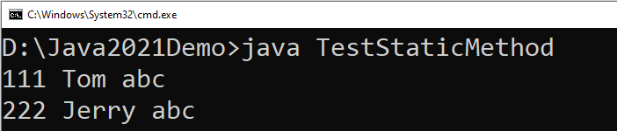
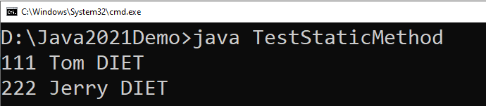
class Student {
int rollno;
String name;
static String college="abc";
static void change() {
college = "DIET";
rollno = 10;
}
Student(int r, String n) {
rollno = r;
name = n;
}
void display() {
System.out.println(rollno+" "+name+" "+college);
}
}
class TestStaticMethod {
public static void main(String args[]) {
Student.change();
Student s1 = new Student(111,"Tom");
Student s2 = new Student(222,"Jerry");
s1.display();
s2.display();
}
}
We can not use non-static variables in static methods

Slide 24
static block
static block is executed exactly once, when the class is first loaded.
It is used to initialize static variables of the class.
It will be executed even before the main method.
Syntax:
static {
//initialisation of static variables…
}

Slide 25
Mutable and Immutable
The content of mutable object can be changed, while content of immutable objects can not be changed.
class MutableClass{
int a;
void add5() {
a = a + 5;
}
}
public class MutableClassDemo {
public static void main(String[] args) {
MutableClass m1 = new MutableClass();
m1.a = 10;
m1.add5();
System.out.println(m1.a);
}
}
class ImmutableClass{
int a;
int add5() {
return ( a + 5 );
}
}
public class MutableClassDemo {
public static void main(String[] args) {
ImmutableClass m1 = new ImmutableClass();
m1.a = 10;
int ans = m1.add5();
System.out.println("A in m1 = " + m1.a);
System.out.println("returned = " + ans);
}
}

Slide 26
Passing Objects as Argument
In order to understand how and why we need to pass object as an argument in methods, lets see the below example.
class Time{
int hour;
int minute;
int second;
public Time(int hour, int minute, int second) {
this.second = second;
this.minute = minute;
this.hour = hour;
}
void add(Time t) {
this.second += t.second;
if(this.second>=60) {
this.minute++;
this.second-=60;
}
this.minute += t.minute;
if(this.minute>=60) {
this.hour++;
this.minute-=60;
}
this.hour += t.hour;
}
}
public class TimeDemo {
public static void main(String[] args) {
Time t1 = new Time(11,59,55);
Time t2 = new Time(0,0,5);
t1.add(t2);
System.out.println(t1.hour + ":" + t1.minute + ":" + t1.second);
}
}

Slide 27
Array of Objects
We can create an array of object in java.
Similar to primitive data type array we can also create and use arrays of derived data types (class).
class Student{
int rollNo;
String name;
public Student(int rollNo, String name) {
this.rollNo = rollNo;
this.name = name;
}
void printStudentDetail() {
System.out.println("| "+
rollNo
+" | -- | "+
name +" |");
}
}
public class ArrayOfObjectDemo {
public static void main(String[] args) {
Student[] stu = new Student[3];
stu[0] = new Student(101,"darshan");
stu[1] = new Student(102,"arjun");
stu[2] = new Student(103,"java");
stu[0].printStudentDetail();
stu[1].printStudentDetail();
stu[2].printStudentDetail();
}
}

Slide 28
Package (Not part of this Unit)
A Package can be defined as a grouping of related types providing access protection and name space management.
Programmers can define their own packages to bundle group of classes/interfaces, etc.
Packages are used in Java in order to
prevent naming conflicts
control access,
make searching/locating of classes/interfaces easier.
It is a good practice to group related classes implemented so that a programmer can easily determine that the classes, interfaces are related.

Slide 29
Creating a package
To create a package you need to write package statement followed by the name of the package.
Syntax : package package_name;
Example :
The package statement should be the first line in the source file.
There can be only one package statement in each source file, and it applies to all types in the file.
If a package statement is not used then the class/interfaces will be put into an unnamed package.
package darshan_student;
class Student {
// code
}

Slide 30
Package (Example)
To compile
javac –d . Animal.java
To Run the class file
java myPackage.Animal
package myPackage;
public class Animal {
public String name;
public void eat(){
System.out.println("Organic Food !!!!");
}
public static void main(String[] args){
Animal a = new Animal();
a.eat();
}
}
.
Represent the current directory

Slide 31
Programs
Write a class named Rectangle to represent a rectangle. It contains following members: Data: width (double) and height (double) that specify the width and height of the rectangle. Methods: 1. A no-arg constructor that creates a default rectangle. 2. A constructor that creates a rectangle with the specified width and height. 3. A method named getArea() that returns the area of this rectangle. 4. A method named getPerimeter() that returns the perimeter.
Write a program to create circle class with area function to find area of circle.
Define time class with hour and minute. Also define addition method to add two time objects.
Declare a class called student having following data members:id_no, no_of_subjects_registered, subject_code, subject_credits, grade_obtained and spi. Define constructor and calculate_spi methods. Define main to instantiate an array for objects of class student to process data of n students.

